Slide 1
BLOCKCHAIN POWERED E-commerce WEB APPLICATION
SUBMITTED BY:
ROHIT SAMAL (1805547)
SHASHI GUPTA (1805555)

Slide 2
Introduction
Our Project Blockchain Powered E-commerce Web Application is an web based application showing the use of these SmartContracts. In our project we use the smart contracts of the Ethereum Blockchain. In our web application Adding product to the Customer section, Placing Order, Order Details, Processing Orders, Received Order feedback, all have done with the use of Ethereum SmartContracts . They are used for making these methods. These SmartContracts are uploaded on the Ethereum Blockchain in the form of opcodes and these are accesed by using web3 to interacts with frontend users.

Slide 3
Objectives:
Implementing Ethereum SmartContracts on E-Commerce.
Decentralized database for E-Commerce platform.
Using Web3 to Interacting with SmartContracts

Slide 4
Technical requirement:-
Node latest version
Npm
Truffle
Ganach-cli
Bootstrap
ReactJs
Web3

Slide 5
Methodology:
First we create our smart contracts for performing functions by customer and supplier i.e. adding, order and receive the product
Then we compile those smart contracts and migrate them to the Ethereum Server. For this we have to start the Ethereum test server.
Then we take Supplier and Customer contract address.
With the help of Supplier and Customer Smart contract addresses we use web3 to combine frontend with the backend.
Then we design our frontend so it can interact with the SmartContracts on the Ethereum BlockChain

Slide 6
Testing Techniques and Test Plans :-
We will test our project by compiling and migrating the smart contracts on Ethereum test network. If they are compiled and migrate successfully then test is successful.
We will use web3 to access these smart contracts if they are accessed successfully then test is successfull.
We will perform features of frontend to check that the Supplier and Customer SmartContracts are fully functional.
That is order placing, adding products, processing order all the function doing work properly

Slide 7
System Design
Smart contracts are compiled using truffle and converted into bytecode when the contract is deployed. This bytecode is then stored on the blockchain, and an address is assigned to it.
Then these Smart Contracts deployed on the Ethereum Server using true. Then the address of these smart contracts will get by the truffle console.
Web3 connect with these smart contract using these address and contract ABI(Application Binary Interface). The ABI denes the functions and types used in the contract.
4. Now web3 connects frontend to these smart contracts so fronted user can use function dened on these contracts and complete their processes according to their application.

Slide 8
1. npm install -g truffle
2. npm install -g ethereumjs-testrpc
3. ganache-cli -1 9000000000 -p 8484
4. .\node_modules\.bin\truffle compile
5. .\node_modules\.bin\truffle migrate
6. .\node_modules\.bin\truffle console
7.Supplier.address
8.Customer.address
9. cd frontend
10. npm start

Slide 9
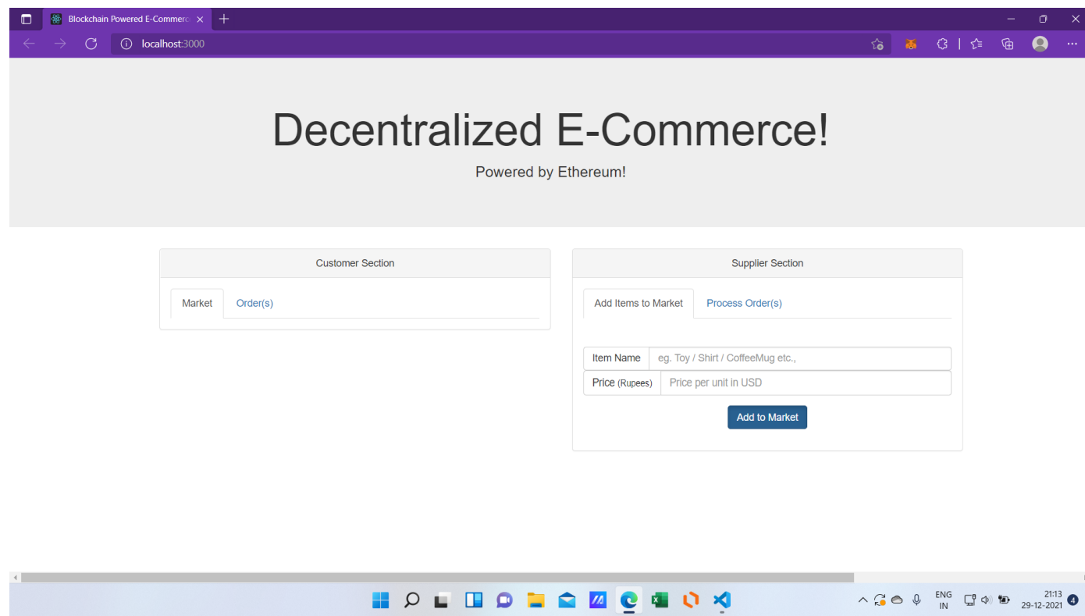
Results:
Home Page

Slide 10
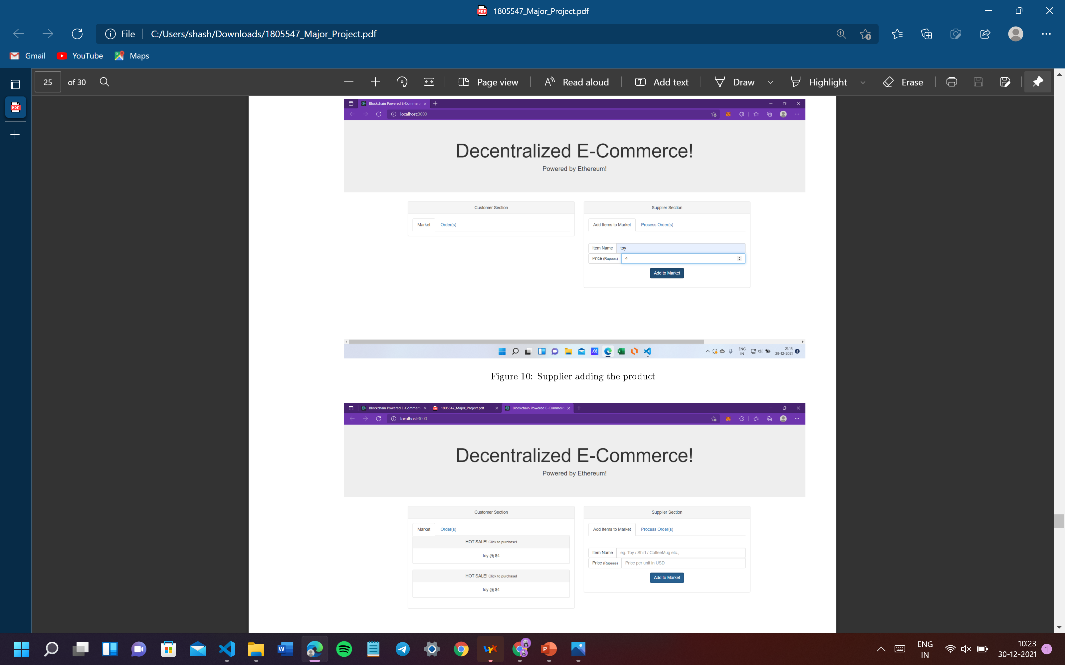
1. Supplier adding the product

Slide 11
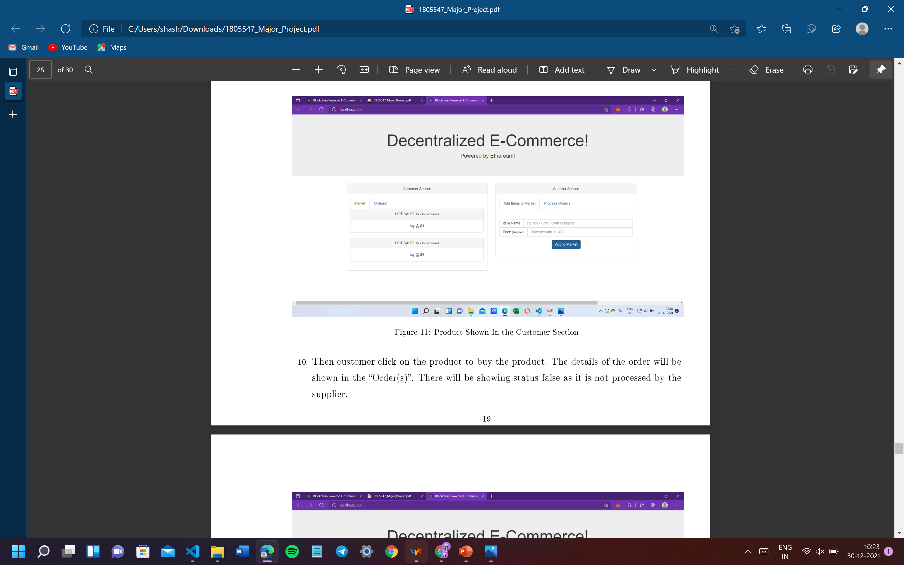
2. Product Shown In the Customer Section

Slide 12
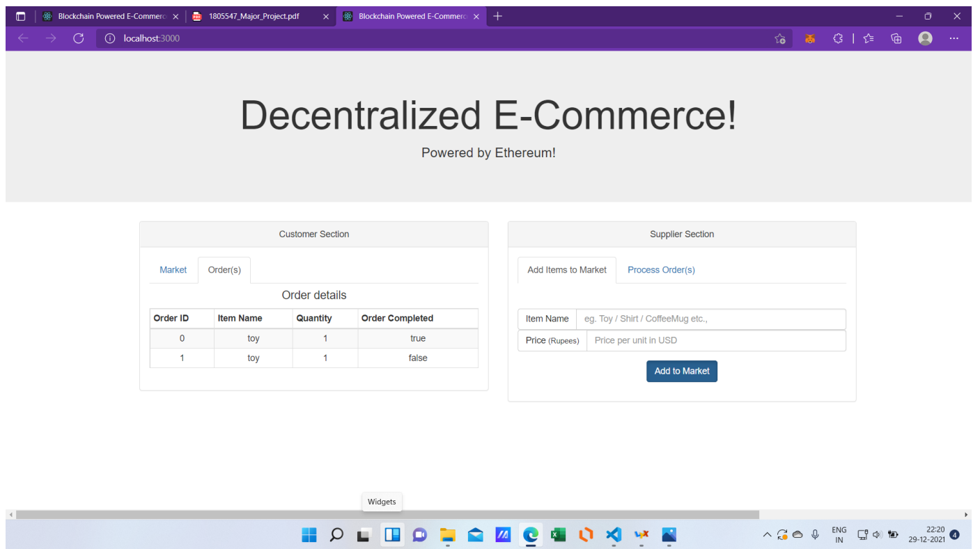
3. Processed Order Page

Slide 13
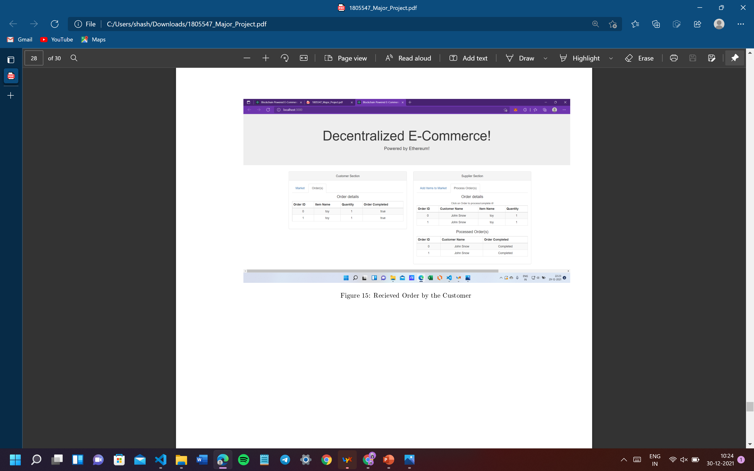
4. Order Processed

Slide 14

5. Received Order by the Customer

Slide 15
Conclusion and Future Scope
Conclusion:
This project is to provide supplier to add the product in the marketplace with price. The customer can view the added product in the market place and buy it and get the order details. The supplier can view the order placed and processed that order. The customer can see the feedback by the supplier that order is processed and received by the customer.
Future Scope:
The future scope of this project is that it gives us the idea of using Blockchain Smartcontracts on the real world application. It tell us that we can use BlockChain as a database with the help of SmartContracts.

Slide 16
THANK YOU

